Slide 1



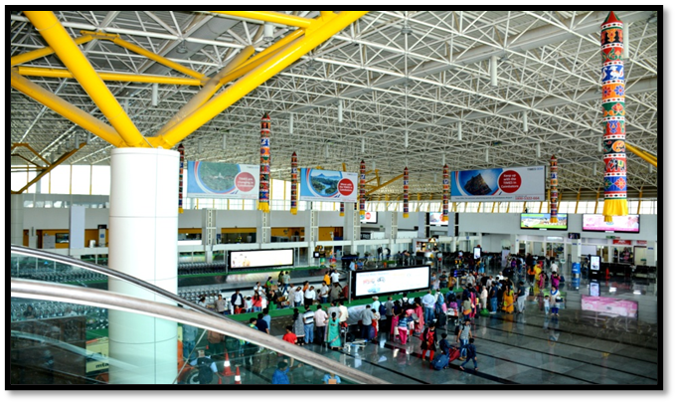
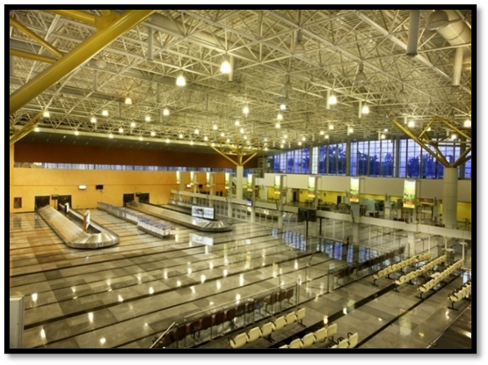
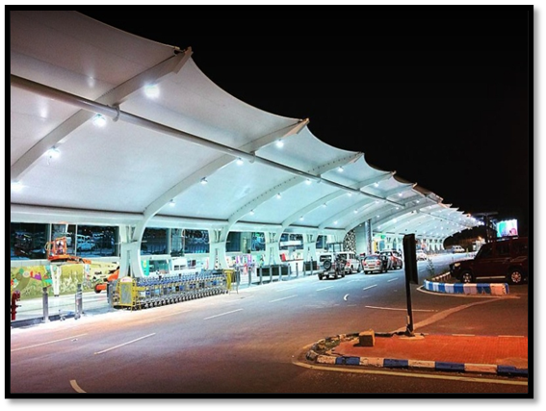
November 22, 2022
AIRPORTS AUTHORITY OF INDIA
COIMBATORE INTERNATIONAL AIRPORT

Slide 2
Members of Airport Advisory Committee Meeting
S.NO | NAME | POSITION
1 | Shri P.R.NATARAJAN, Hon. MP | Chairman
2 | Shri M. ArunKumar, Hon. MLA | Alternate Chairman
3 | Shri Raja Gopal Sunkara, IAS | Commissioner Corporation of Coimbatore
4 | Smt. Leela Alex | DRO Coimbatore
5 | Smt. E.S. Uma, IPS | Deputy Commissioner of Police Coimbatore South
6 | Shri M.Karthikeyan, Hon. Secretary | Representative of Trade Association Coimbatore
7 | Shri B Selvaraju, President | Representative of Travel&Tour/Taxi Association, Coimbatore
8 | Shri M.Sivakumar, Secretary, Coimbatore District Hoteliers Association | Representative of Industry Coimbatore(Airlines/Hotel Federation,etc)
9 | Shri N.Karthick | Prominent Citizen of social and Political background
10 | Shri C.M. Rajendran | Prominent Citizen of social & Political background
11 | Shri Vipul Patel | IT Expert and Social Worker(MoCA nominated member)

Slide 3
Air services by Coimbatore airport
Ahmedabad
Jaipur
Kolkata
Pune
Durgapur
Coimbatore Airport
Guwahati
Mumbai
Chennai
Bangalore
Raipur
Hyderabad
Delhi
Vizag.

Slide 4



Operating Airlines
International
Air Arabia
Scoot Tiger
Domestic
Air India
Indigo
Vistara

Slide 5
Aircraft Movement at Coimbatore airport
Financial Year | Aircraft
 | Domestic | International
April 2019 to March 2020 | 21068 | 1947
April 2020 to March 2021 | 8448 | 250
April 2021 to March 2022
April 2022 to October 2022

Slide 6
Passenger Movement at Coimbatore airport
Financial Year | Passenger
 | Domestic | International
April 2019 to March 2020 | 2606641 | 238232
April 2020 to March 2021 | 821311 | 26492
April 2021 to March 2022
April 2022 to October 2022

Slide 7
Cargo Handled at Coimbatore airport
Financial Year | Cargo (In Tons)
 | Domestic | International
April 2019 to March 2020 | 9958.01 | 3793.286
April 2020 to March 2021 | 6763.531 | 1128.441
April 2021 to March 2022
April 2022 to October 2022

Slide 8

Commodities Handled
EXPORTS
IMPORTS
Fabrics
Textile Machinery Spares
Castings, Pumps
Tools & Engineering Goods
Assorted Vegetables
Flowers, Fruits, Food stuffs
Ayurvedic products
Spices
Garments
Accessories
Electrical and Electronic Goods
Gold Bars
Machinery Components
Unaccompanied Baggage

Slide 9


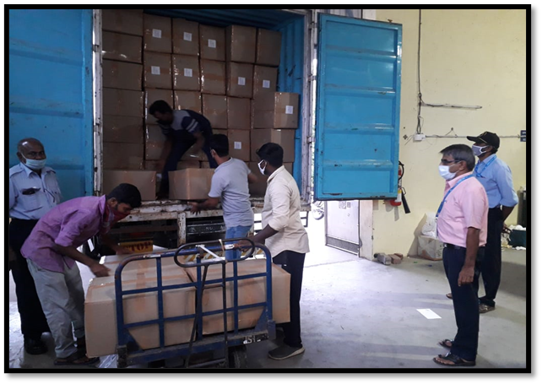
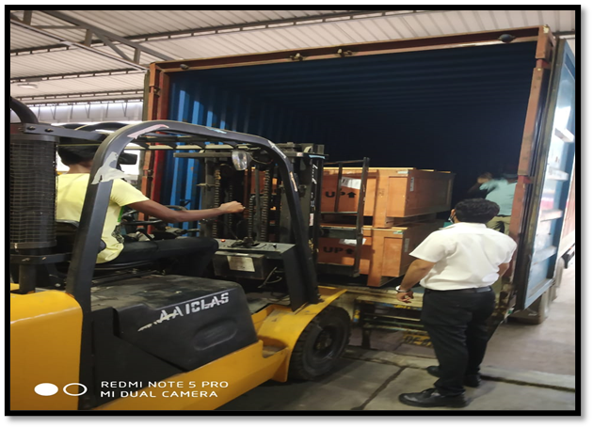
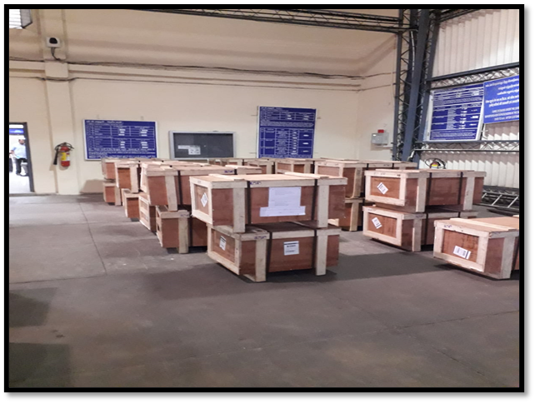
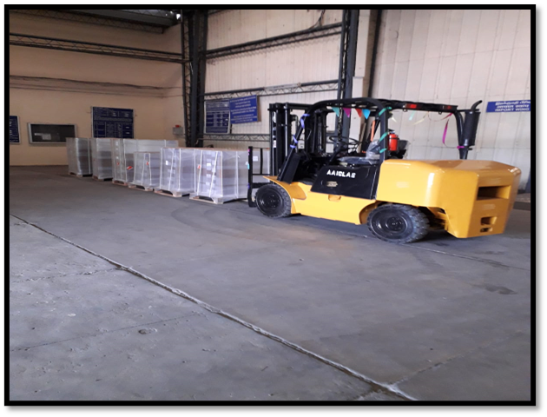
Cargo Development & Handling
Bonded Trucking Services started by Air India from Coimbatore to Gateway Airports (Sept-21).
Bonded Truck Movement from Coimbatore to Mumbai also started.
Scoot Air started uplifting Perishable Cargo,post Covid Operation.
During 2021-22 Cargo Handling increased to 22% with 8062 Metric Tons from 6560 Metric Tones in 2020-21.

Slide 10

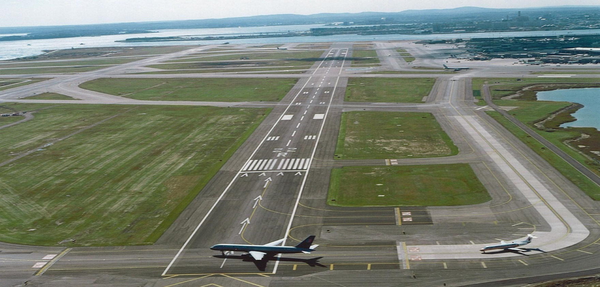
Runway Specifications
Airport License : Valid upto 15.04.2023
Runway :2990 mtr. X 45 mtr.
Runway Orientation :Rwy. 05/23
Taxiways :5
Parking Bays :10(additional 7 bays are in the final stages of commissioning)
Surveillance :ADS-B
No. of diversion allowed : 2(max)
No. of night parking's :3(max)
NSOP with permanent : 2 (LMW & Thriveni Earth base in Coimbatore Movers)
Critical Aircraft : A321

Slide 11

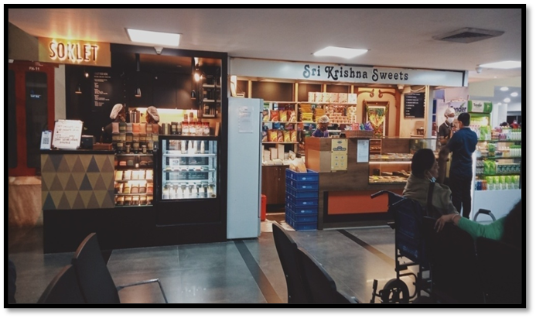
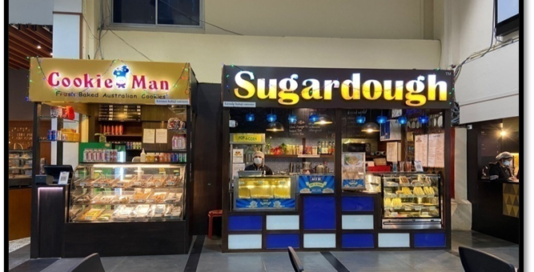
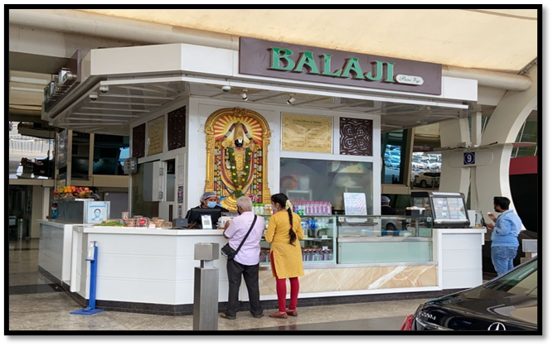
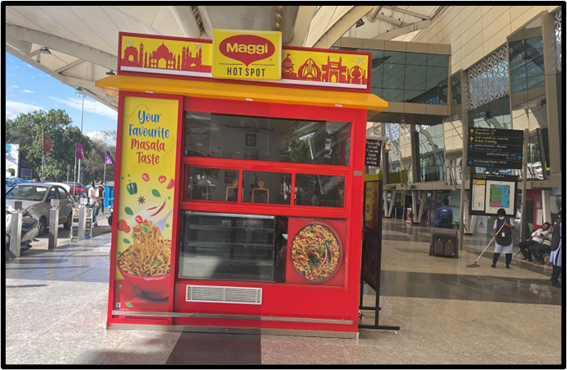
FOOD &SHOP OUTLETS

Slide 12
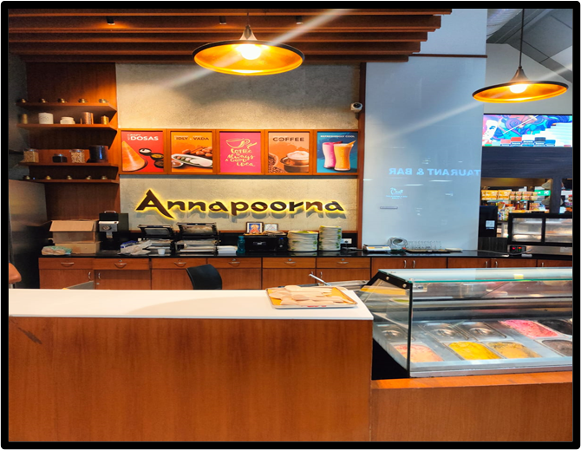
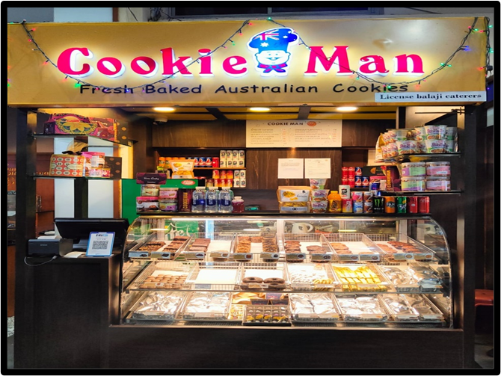
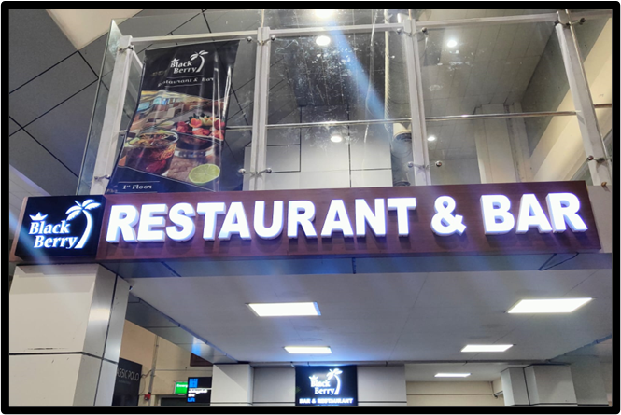
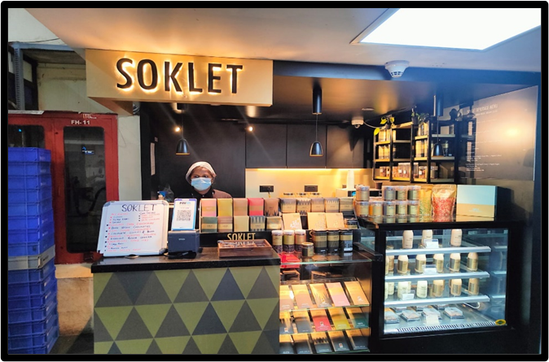

Slide 13
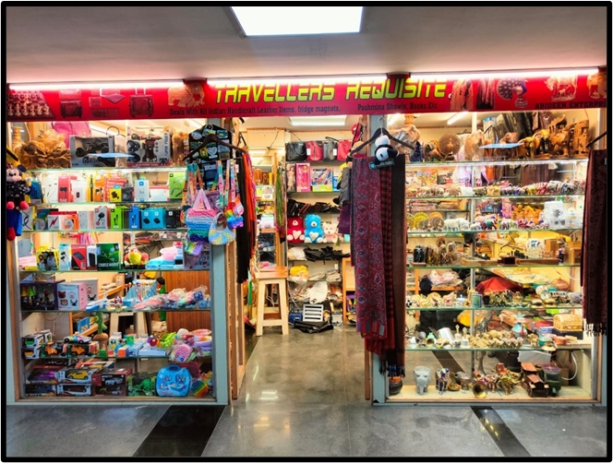
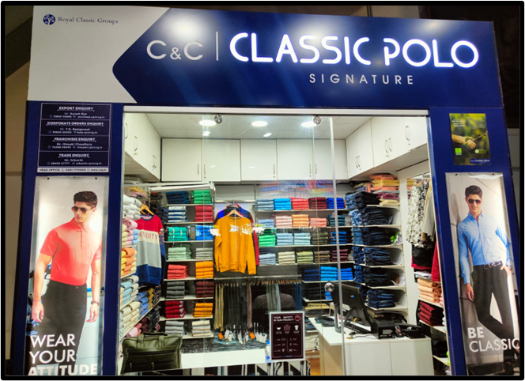
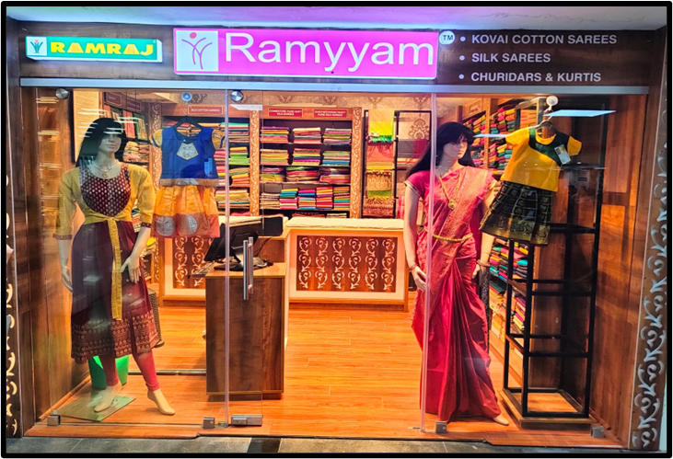
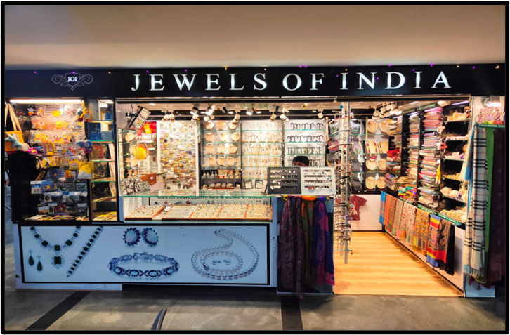

Slide 14


CONCESSIONAIRES
RAMRAJ GARMENT OUTLET
RAMYAM TEXTILE SHOP
TRIBAL HANDICRAFTS OUTLET(TRIFED)
POOMPUHAR OUTLET
AYURVEDIC COSMETIC PRODUCTS OUTLETS
ARTIFICIAL JEWELLERY OUTLET
TRAVEL REQUISITES OUTLET
RESTAURANT AND SNACK BAR
RESTAURANT – ANNAPOORNA
COOKIE MAN
OPEN DOORS AT INTL SHA
OPEN DOORS ARRIVAL
SOKLET
SRI KRISHNA SWEETS
SUGAR DOUGH
MAGGI COUNTER
BALAJI PURE VEG (CITY SIDE)

Slide 15

PARKING CHARGES
Vehicle Type | Upto 30 min(Rs) | 30 min- 2 hours(Rs)
Coach/Bus/Truck | 30 | 70
Tempo/SUV/Mini bus | 20 | 60
Car | 20 | 55
TwoWheeler | 10 | 15
>2 hrs- car- inc Rs 10 per hr,bike-Rs5 per hr
>7&<24 - hours- 300% of the 30 minutes to 120 minutes' slab and every 24 hours or part thereof.
Monthly Passes also available for staff of authorized agencies.
Mandatory for all vehicles to take entry slips for data purpose.

Slide 16
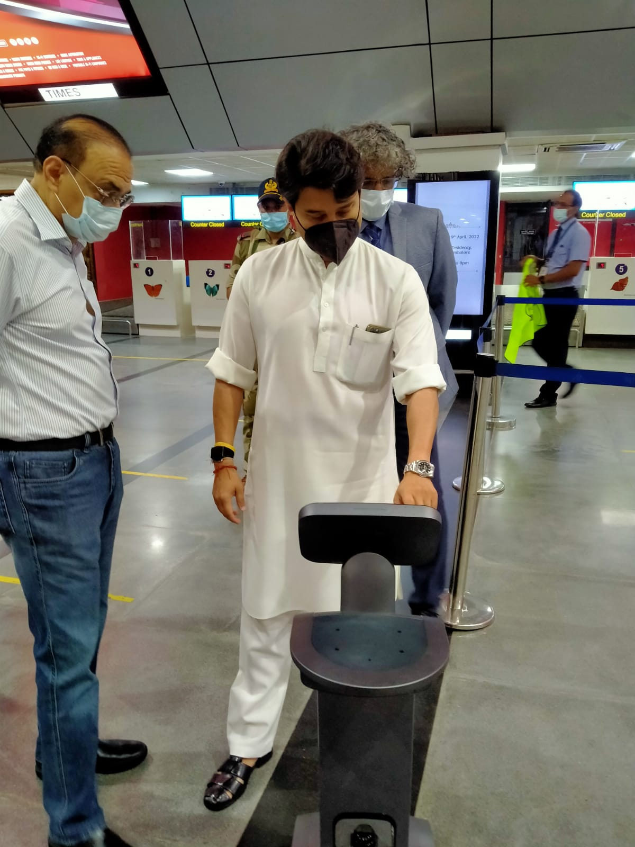
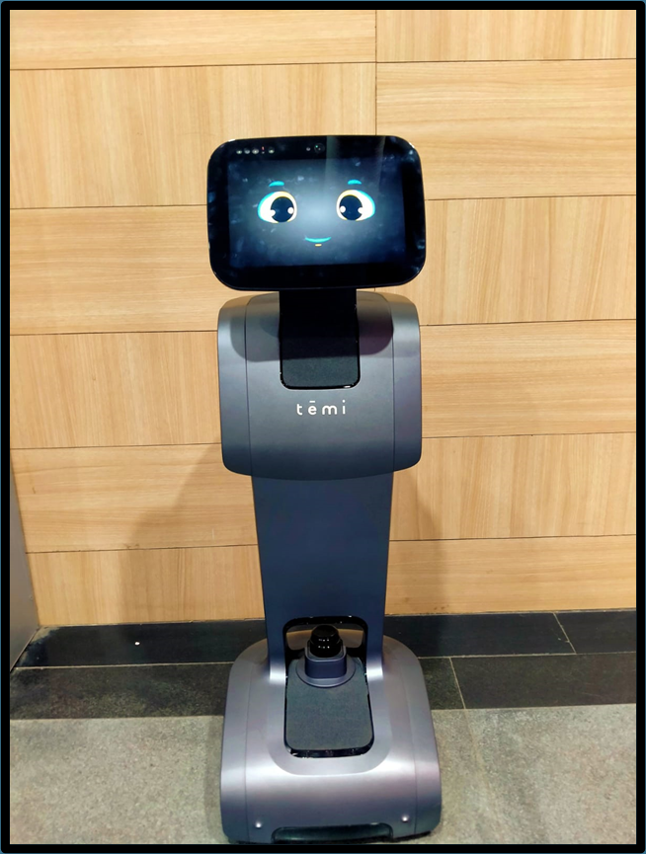

FACILITATION EQUIPMENTS
AI based smart
assistance “My robot”

Slide 17
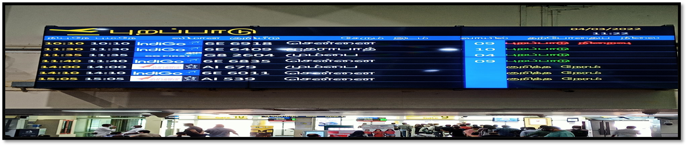
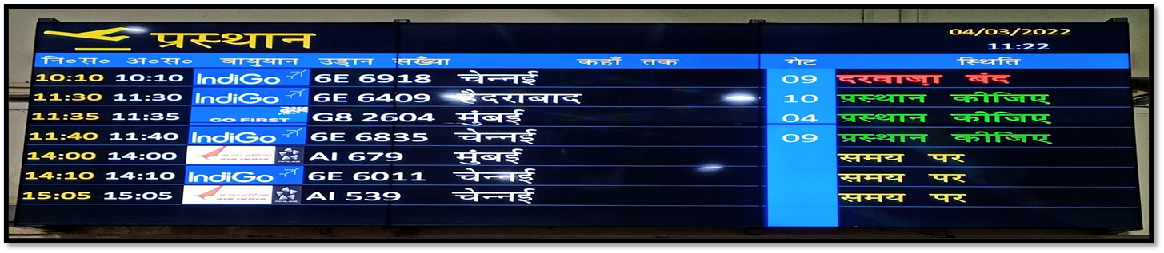

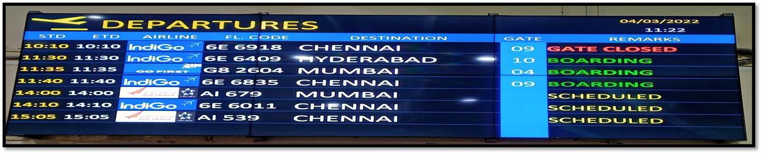
TRI-LINGUAL FIDS INFORMATION

Slide 18
Support services for aircraft operations , passenger safety and security

Slide 19
INTEGRATION OF RADAR DATA
Coimbatore ATS Automation system is integrated with VOCI, VOBL, VOSX Radar data apart from local ADS-B
VOCI & VOBL data integrated through MPLS Circuits since June 2018.(Primary Link – BSNL, Secondary Link – RAILTEL)
SULUR AFS radar data integrated through MLLN (BSNL) & RF Link circuits since October 2018. VOSX radar data available only during ATC watch hour of Sulur AFS. Signing of MOU is pending with IAF.
ADS-B data is uplinked in the surveillance cloud and presently used by Chennai, Trichy, Bangalore, Cochin Automation systems.
ADS- B and Automation is operational H24, unmanned during night & holidays due staff shortage
ATS AUTOMATION / SURVEILLANCE

Slide 20

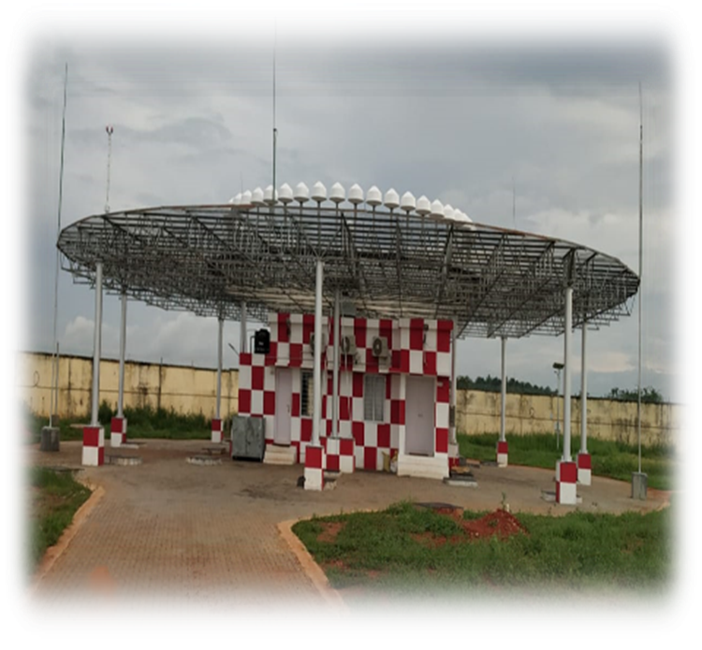
New DVOR/HP-DME
Replacement of DVOR done, commissioning awaited.
New DVOR equipment is from South Korean manufacturer M/s Mopiens and DME is Canadian make INTELCAN. Commissioning checks were carried out by the flight inspection unit of AAI.
This was a 2.3 crore project.

Slide 21
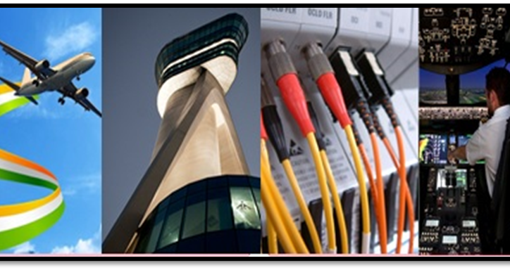
Futuristic Telecommunication Infrastructure (FTI)
One of the premier AAI project FTI (Futuristic Telecommunication Infrastructure) system is installed and Commissioned on 1st Sep 2021.
With this seamless uninterrupted and redundant communication will be established with other airports for exchanging AFTN messages and surveillance data.
This key project is undertaken by AAI in collaboration with M/s Harris corporation and FTI is for a period of 15 years at a cost of 945 crores.

Slide 22
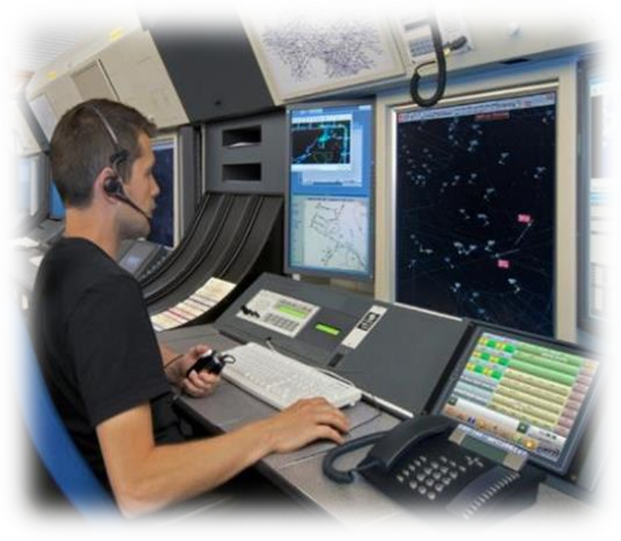

Voice Switching Controlling and Recording unit (VCS)
State of art of voice switching controlling and recording unit is also at the verge of commissioning.
The Italian manufacturer M/s SITTI has supplied the machine for our airport. This equipment caters for the extended communication facilities which is proposed for strengthening the coverage limits of the Cochin area control center.
Along with this an addition of few IP based VHF transmitters and receivers also will be installed

Slide 23
Airport systems &BDDS Equipments
SECURITY EQUIPMENTS
XRAY BAGGAGE INSPECTION SYSTEM (XBIS)
EXPLOSIVE TRACE DETECTORS (ETD)
DOOR FRAME METAL DETECTORS (DFMD)
HAND HELD METAL DETECTORS (HHMD)
SURVEILLANCE EQUIPMENTS
SCCTV SYSTEM
APRON CAMERA SYSTEM
BREATH ANALYSER Test Camera System
BDDS EQUIPMENTS
NIGHT VISION GOGGLES
BOMB SUIT EQUIPMENT
EXPLOSIVE VAPOUR DETECTOR
VARIOUS BDDS EQUIPMENTS (4 Items)
REAL TIME VIEWING SYSTEM
ELECTRONIC STETHOSCOPE
BLAST INHIBITOR
FIBER OPTIC SERVEILLANCE DEVICE

Slide 24
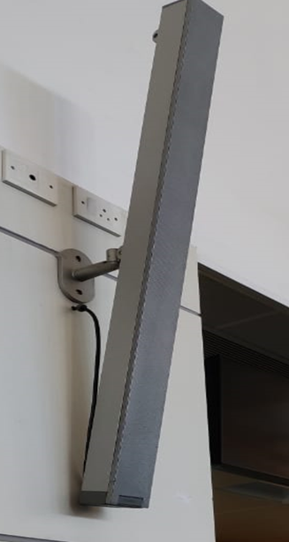
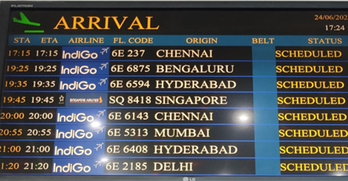
FACILITATION EQUIPMENTS
PUBLIC ANNOUNCEMENT
SYSTEM (PA SYSTEM)
FLIGHT INFORMATION
DISPLAY SYSTEM (FIDS)

Slide 25
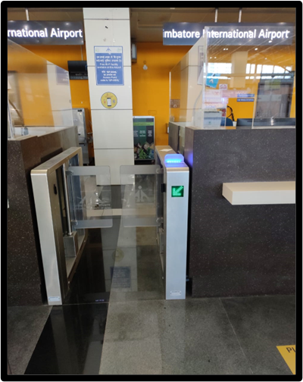
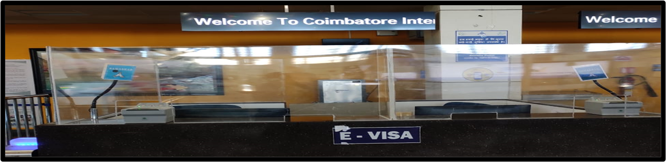
DYNAMIC SIGNAGE FOR
IMMIGRATION COUNTERS (DSS)
AUTOMATIC ELECTRONIC ACCESS CONTROL SYSTEM FOR IMMIGRATION COUNTERS (E-GATES)

Slide 26

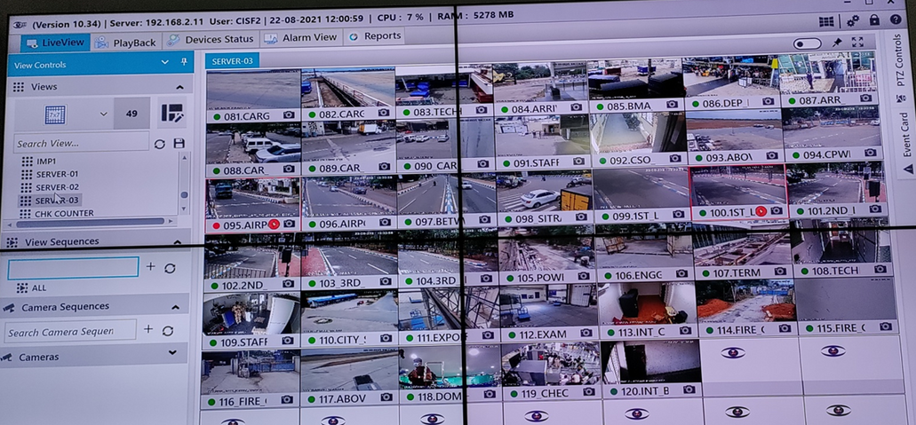
SCCTV- 226 CAMERAS
Manpower Resurvey(MPRS) for ASG(Airport Security Group) personnel conducted by BCAS. The committee is of the opinion to enhance the strength to 422 against the existing manpower of 252 for smooth & efficient functioning of operations in domestic terminal, international terminal & cargo. Proposal has been sent to MHA for approval.
?Almost all buildings in the airport premises are security vetted including proposed new domestic terminal building.?
Coimbatore Airport has fully established biometric centralized access control system.?
94% of the agencies working inside the airport are security cleared as per MHA and BCAS guidelines. Remaining 6% to be tracked at the earliest.?

Slide 27
CISF helpdesk established at Coimbatore International Airport received the 1st prize in the southern region.?
Facilities provided by Coimbatore airport to ASG has been adjudged 2nd among all airports managed by Airports Authority of India that is far best than the facilities provided by private airline operators.?
1 dog Johnny serving at Coimbatore ASG unit got the 1st prize in the training center.
1 CISF control room is established at the airport to monitor the security of assets and people 24*7.

Slide 28
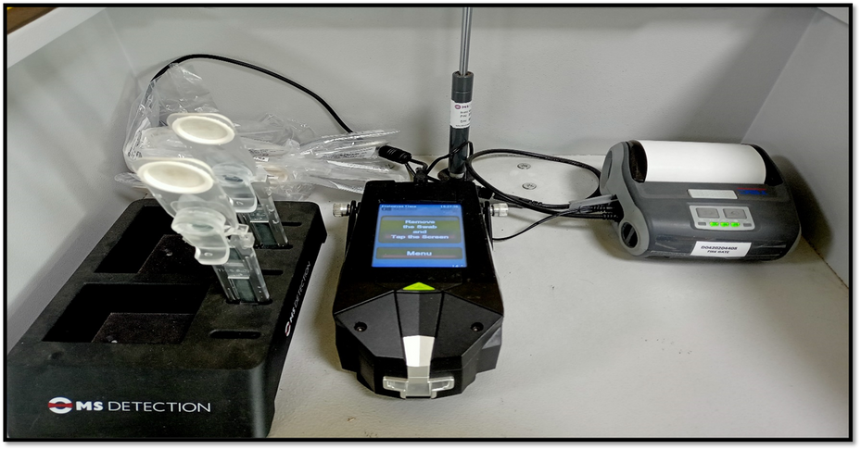
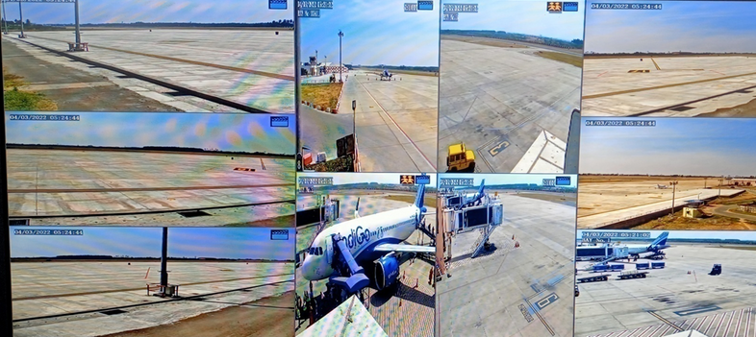
New Facilities provided by Airport Systems
State of the art with latest technology Explosive Trace Detectors have been procured and provided in Operation for enhancing the Security of Airport.
For providing apron control in the newly constructed Aprons and assisting to the Air traffic controller, New HD Cameras have been provided for better view and monitoring to ATCO’s at ATC Tower.

Slide 29

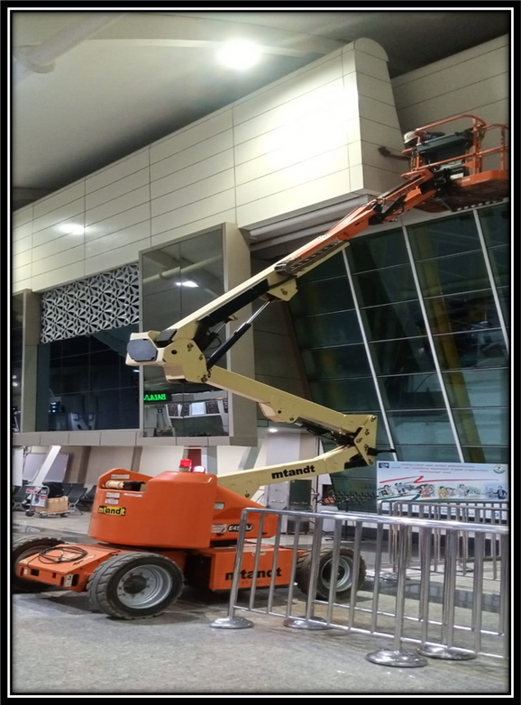
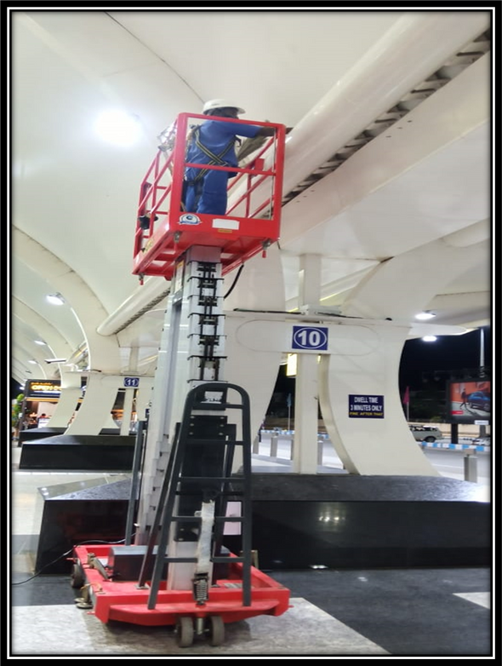

MECHANIZED CLEANING OF THE TERMINAL BUILDING AND ANCILLARY BUILDINGS

Slide 30
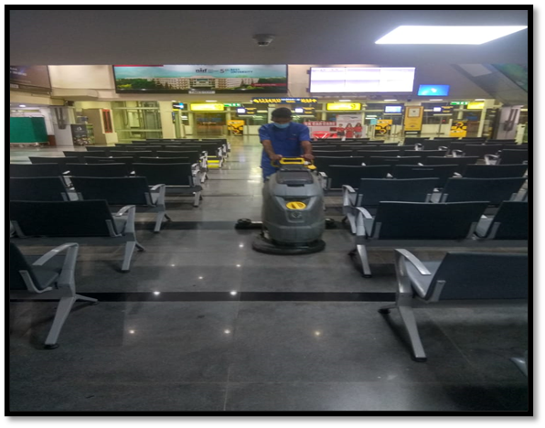
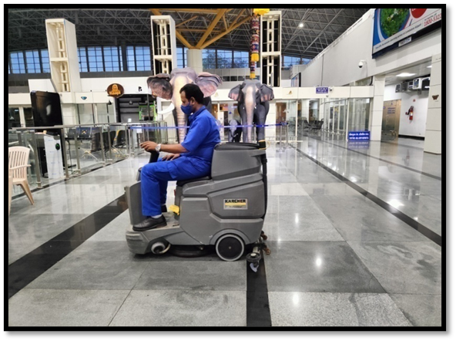
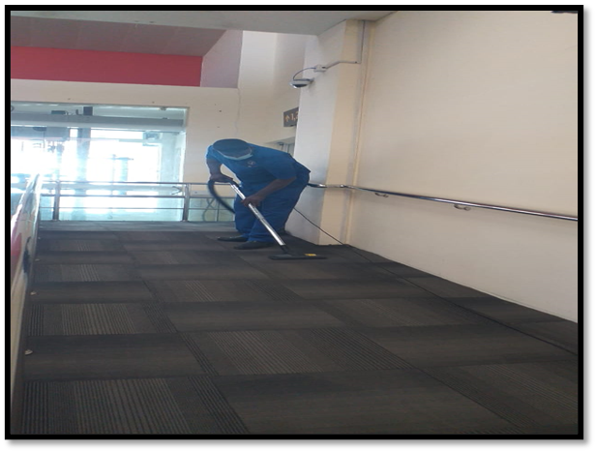
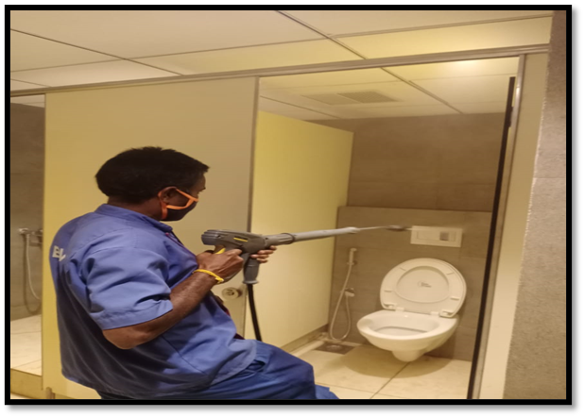

Slide 31
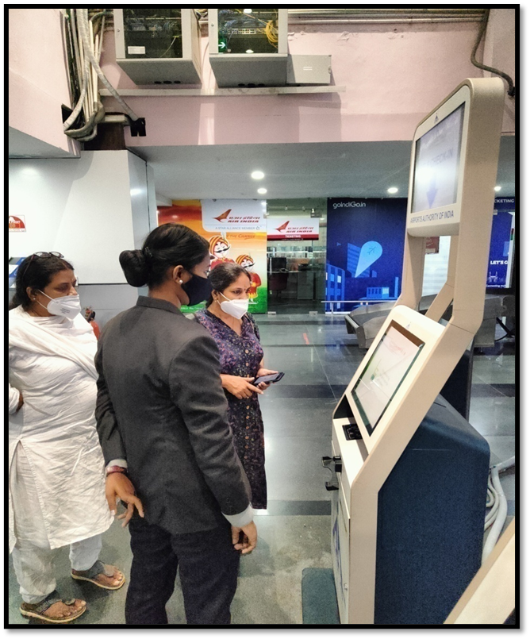
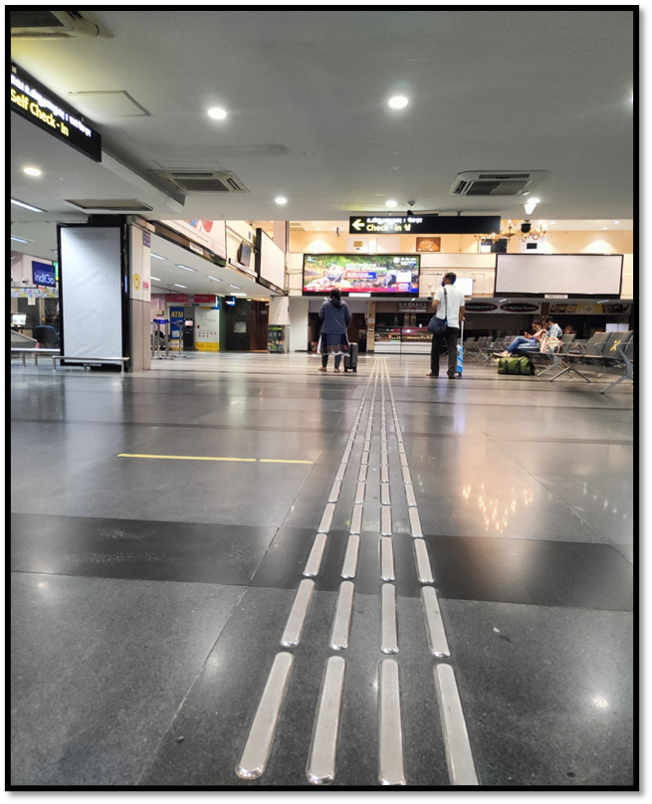
“May I help you” service and Tactile Flooring for PRM passengers

Slide 32
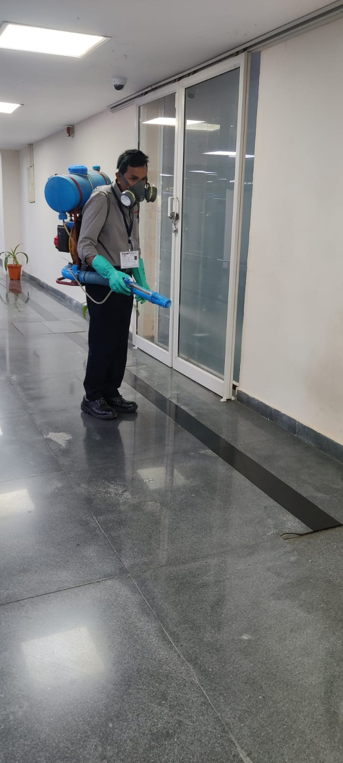
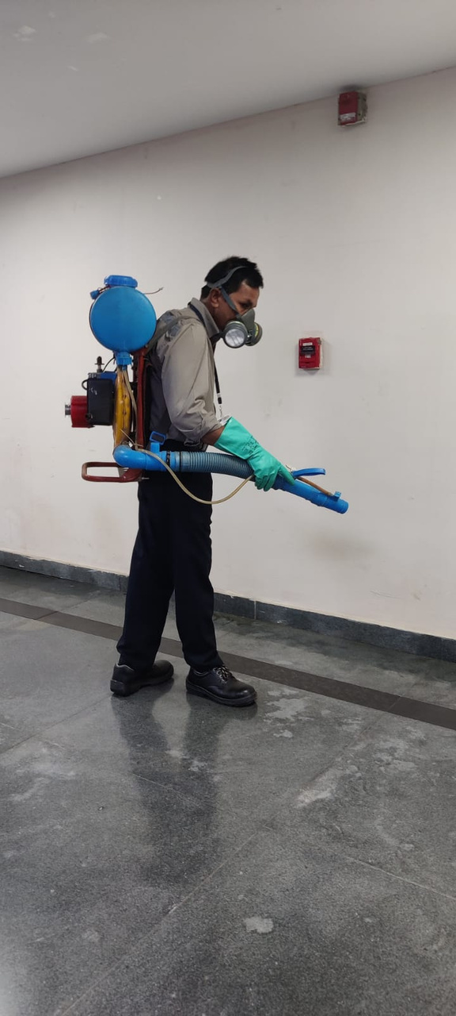
Regular Spray & Fogging to ARREST MOSQUITO MENACE

Slide 33


CSS & performance of airport in the survey
CSS stands for ‘Customer Satisfaction Survey’
The survey is conducted twice in a year in two rounds.
It takes various parameters into account, including parking facility, availability of trolleys, efficiency of check in staff, waiting time, helpfulness of staff, ease of finding way through the airport, facility for eating and availability of feeling safe and security.

Slide 34
Results of CSS survey Round-1 2021
Overall satisfaction of passengers was rated 4.18 on a scale of 5.
Top 3 parameters in which passengers rated us the most
-Passport/ID inspection-4.95
-Cleanliness of airport terminal-4.93
-Speed of baggage delivery-4.92
Top 3 parameters in which passengers rated us the least
-Courtesy and helpfulness of security staff-4.36
-Thoroughness of security inspection-4.38
-Waiting time at security inspection​-4.40
The next Customer Satisfaction Survey is planned on the 1st week of April 2022.

Slide 35

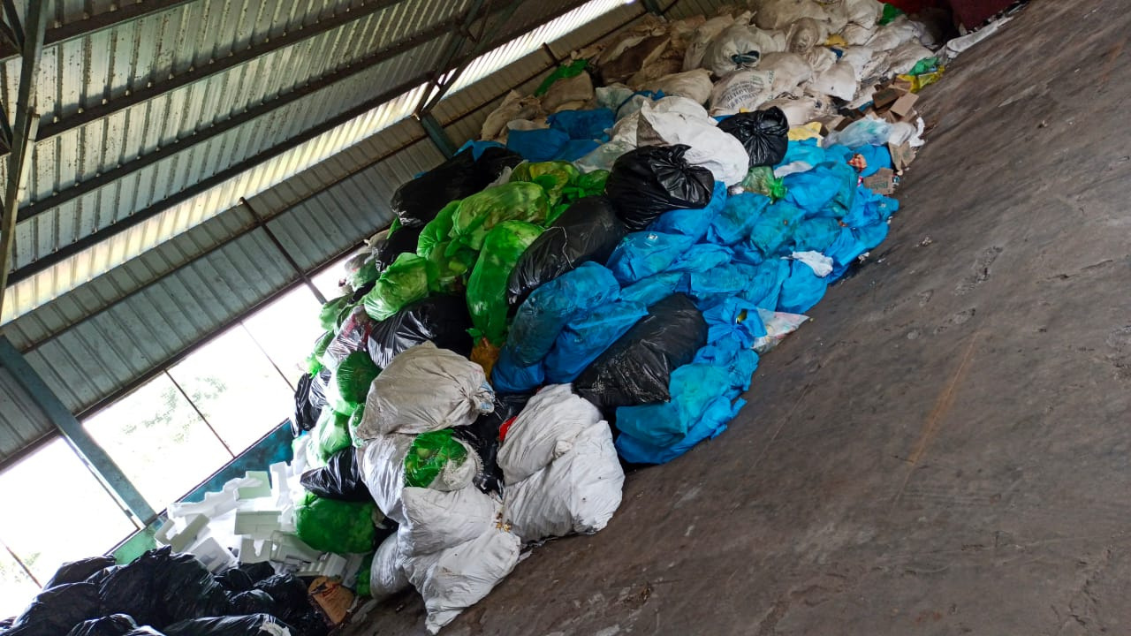
Solid Waste Management
Clean City Foundation is providing facility to take care of solid waste and garbage management at airport.
Contract has been awarded to Clean city foundation at a cost of Rs.2.93 crores for a period of ten years. The agency has commenced work on 01.04.2019.

Slide 36

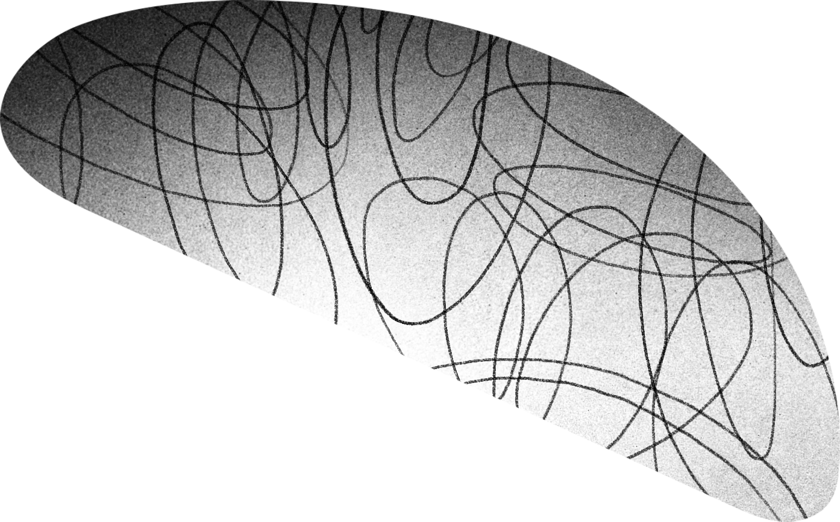
















TAMIL NADU TOURISM PHOTOS AT AIRPORT PREMISES

Slide 37
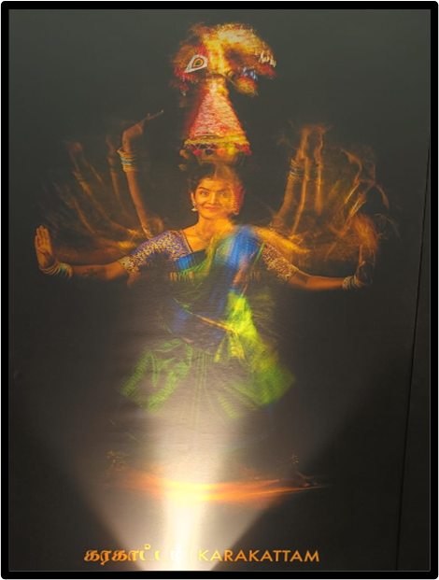
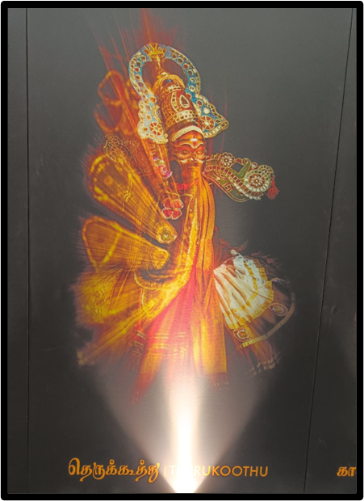
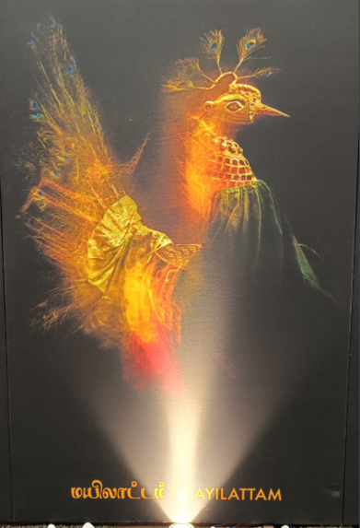


Slide 38



Slide 39


COIMBATORE AIRPORT FIRE SERVICE

Slide 40
SAFETY SERVICES VEHICLES
Ambulances Details:
No. of Vehicles : 03
Crash Fire Tenders:
No. of ACFTS : 04

Slide 41


Mobile Command Post
They enable quick response and uninterrupted communications. Not only are mobile command centers useful during critical incidents but they can be an extremely effective community outreach tool.

Slide 42


Disaster Management Equipment
PORTABLE SHELTER
HUMAN LIFE DETECTOR AND VICTIM LOCATOR

Slide 43


Human Life Detector &
Victim Locator
Human life detector is useful to identify the Human lives trapped in the debris.
Victim Identification device is useful to find out and communicate with the trapped Victims during an accident.

Slide 44




Partial Emergency Exercise - 2022

Slide 45


Partial Emergency Exercise - 2022

Slide 46

Double gate system commissioned with electrically operated swing gate

Slide 47
Projects
Ultraviolet Germicidal irradiation (UVGI) system incorporated in Heating, Ventilation and Air Conditioning (HVAC) of terminal building as preventive measure of Covid-19.
De-scaling of chillers carried out which resulted in reduced electricity consumption and enhanced cooling effect.
With Tariff bifurcation, Electricity charges saved up to minimum Rs 6 lakhs /month, yielding reduced operational expenditure.
COMPLETED PROJECTS
Construction and Expansion of Apron (23 crores)
Underground Sump (1.49 crore)
Constant Current Regulator Room (0.43 crore)

Slide 48
ON GOING PROJECTS
Staff Quarters (43.36 crores)
Renovation of Toilet (1.67 crores)
GI Sheet Roofing (2.94 crores)
UPCOMING
Resurfacing of Runway (Tender cost=46.32 Crores)
Expansion of Turn Pad (8.11 crores)
New Domestic Departure Terminal Building (100.36 crores)
Approach Road (3.15 crores)
PLANNING
Construction of New Integrated Cargo Complex (40 crores)
Construction of Administrative block (40 crores)
Construction of Technical Block Cum Control Tower (67.61 crores)
Construction of Boundary wall-Acquired Land (37.28 cores)

Slide 49


STAFF QUARTERS
Project value – 43.8 crs
Capacity – 120 quarters
Hostel block – 12 quarters

Slide 50


RENOVATION OF TOILET
Project value – 1.80 crs
Area - CHK IN, Arrival, SHA (GF & FF), Departure

Slide 51


PROVISION OF GI SHEET ROOFING

Slide 52


EXPANSION OF APRON
Project value – 23.0 Crs
No of bays – 7 nos

Slide 53

RESURFACING OF RUNWAY
Project value – 46.32Crs
Area - Runway
Flexible Portion of Runway``
Severe Localized damages
Stripping of bitumen observed
Water stagnation/Oozing out problem – To be addressed by CRRI
Rigid Portion of Runway
Good condition
Minor damages

Slide 54

CONSTRUCTION OF ADMINISTRATIVE BLOCK
Status: Approval awaited from planning directorate for preparation of Estimate.

Slide 55

Construction Of Technical Block cum Control Tower
Status: Approval awaited from planning directorate for preparation of Estimate.

Slide 56
RNFC
LPH
TNLC
PSF Security
Facilitation
User development fee
Other airport services
6,000
FINANCIAL STATUS
4,000
(Amount in lakhs)
Traffic Revenue
2,000
0
19-20
20-21
21-22
APR22-May22

Slide 57
Concessions
Rent & Services
MISCELLANEOUS
2,000
1,500
(Amount in lakhs)
Non-Traffic Revenue
1,000
500
0
19-20
20-21
21-22
Apr22-May22

Slide 58
Total Revenue
Total Expenditure
Profit- loss
19-20
20-21
21-22
Apr22-May22
-2,500
0
2,500
5,000
7,500
10,000
12,500

Slide 59
User Development/Aviation Security Fees & Employee Data
SECTOR | UDF Charges per Passenger | ASF Charges per Passenger
DOMESTIC | Rs. 350/-+GST | Rs. 200/-+GST
INTERNATIONAL | Rs. 450/-+ GST | USD 12/-+GST
Serving Employees | 169
Retired Employees | 113
Total | 282
CISF | 224

Slide 60
Land Acquisition
For expansion of Coimbatore International Airport required land is 627.89 acres.
Defence Land to be transferred to AAI for an extent of 134.58 acres.
Proposal for Connectivity of L&T Bypass Road with proposed New Approach Road for Coimbatore International Airport and abandoned NHAI Road.
Left out leased land notification pending with Govt. of Tamilnadu for an extend of 6.93 acres.

Slide 61
Land Acquisition
For expansion of Coimbatore International Airport required land is 627.89 acres.
Defence Land to be transferred to AAI for an extent of 134.58 acres.
Defence department given working permission to State government(Chief Secretary to TN).
Enter upon permission awaited from TN govt. to AAI.
Proposal for Connectivity of L&T Bypass Road with proposed New Approach Road for Coimbatore International Airport and abandoned NHAI Road.
Left out leased land notification pending with Govt. of Tamilnadu for an extend of 6.93 acres.

Slide 62

FUTURE MASTER PLAN

Slide 63
Opportunities
APPRENTICESHIP PORGRAM :
As per The Apprenticeship Act 1961, Coimbatore Airport is training students who completed ITI/Diploma/Graduation under Apprenticeship Program.
Each Apprentice is paid a stipend of Rs. 9,000/ Rs. 12,000/Rs. 15,000 for the streams ITI/ Diploma/ Graduate respectively.
INTERNSHIP PROGRAM:
For students of ENGINEERING/ MANAGEMENT colleges so as to provide exposure to Aviation Industry, free of cost. 116 nos. engaged during 2019 (subsequent years NIL due to COVID situation)

Slide 64
Apprentices and Expenditure
PERIOD | NO OF APPRENTICES ENGAGED | EXPENDITURE ON STIPEND(in Lakhs)
19-20 | 42 | 55.92
20-21 | 7 | 6.60
21-22 | 5 | 5.40
**Decrease in no. of apprentices due to COVID situation**

Slide 65
INDUSTRIAL/Internship Program
Industrial Visit
"Nagarathinam Angalammal Arts & Science college", Madurai on 21st Feb 2022
“My Skyfly Aviation India” Madurai on 13.04.2022-22 Students
“Karunya Institure of Technology” Coimbatore on 23.05.2022- 09 students
Internship
“Kasturi Institute of Management” from 20.05.2022 to 27.05.2022 -08 students.
“Hindustan Institute of Technology” Chennai from 27.06.2022 to 15.07.2022.
“Kasturi Institute of Management” from 01.07.2022 to 18.07.2022 - 24 students.
“Amrita school of Business” Coimbatore from 23.05.2022 to 22.07.2022.

Slide 66
EVENTS at Coimbatore Airport

Slide 67



National Unity Day

Slide 68



Onam Celebration

Slide 69



Independence Day

Slide 70


International Yoga Day

Slide 71


Vigilance Awareness Week

Slide 72


Tree Plantation Drive

Slide 73


Special Campaign 2.0 for Swachhata

